Slide 1
Developing a Professional
Image
This Photo by Unknown Author is licensed under CC BY

Slide 2
DEVLOPING A PROFESSIONAL IMAGE
Shanel James
EDTC 5633

Slide 3
Why Develop a Professional Image?
Builds relationships
Builds careers
Career advancement
Builds confidence and pride
This Photo by Unknown Author is licensed under CC BY

Slide 4
What is Professional Image
A professional image is the perception someone projects about themselves. This perception is based on appearance and reputation. Image is based on the way you present yourself to others in a professional environment. Professional image includes; how you dress, communication and the way others speak about you.
This Photo by Unknown Author is licensed under CC BY

Slide 5
Components of a Professional Image
Professional appearance
Professional etiquette
Professional behavior
Professional Communication
This Photo by Unknown Author is licensed under CC BY-NC-ND

Slide 6
Qualities of professionalism
Interpersonal skills
Appearance
Communication skills
Time management
Confidence
Ethics
Work ethic
Knowledge
This Photo by Unknown Author is licensed under CC BY-SA-NC

Slide 7
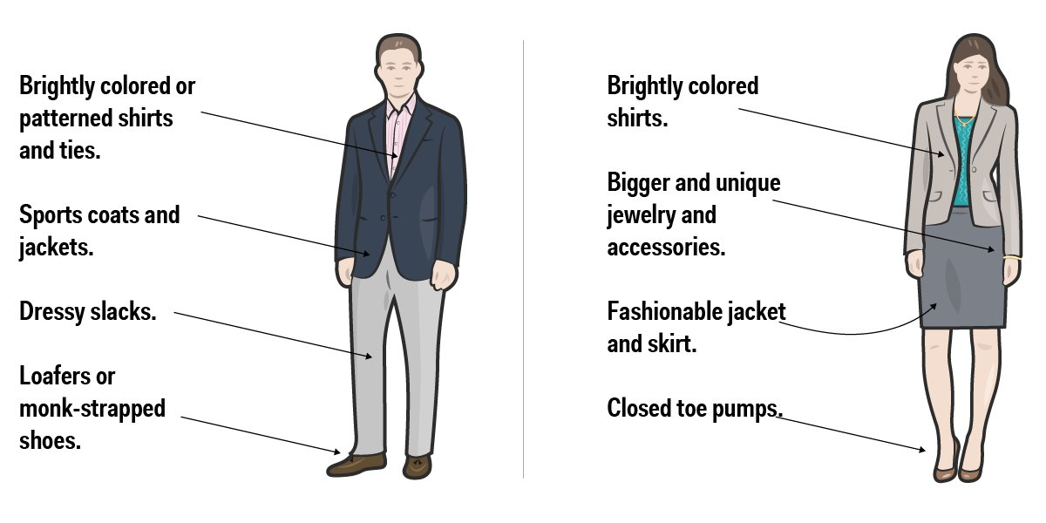
This Photo by Unknown Author is licensed under CC BY-SA-NC

Slide 8
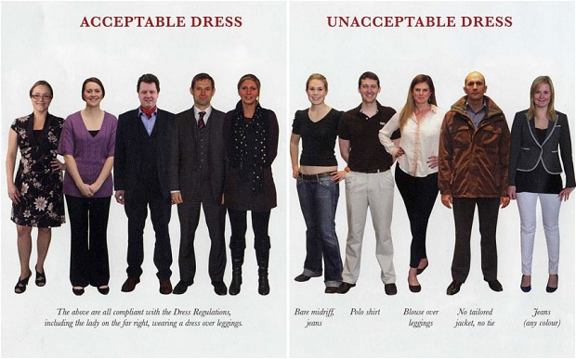
What does your image say about you?
This Photo by Unknown Author is licensed under CC BY-SA

Slide 9
Tips to help Develop your professional image
Join professional associations
Find a mentor
Shadow a colleague
Create a professional development plan
Understand your business model
Diversify your skill set

Slide 10
This Photo by Unknown Author is licensed under CC BY-NC-ND

